Slide 1




Webinar hosted by:
Understanding the “New”
SNAP Time Limit for ABAWDs
Louise Hayes
Supervising Attorney
lhayes@clsphila.org
www.clsphila.org
Kathy Fisher
Policy Director
kfisher@hungercoalition.org
www.hungercoalition.org
Ann Sanders
Public Policy Advocate
anns@justharvest.org
www.justharvest.org

Slide 2
Overview
Basics of the SNAP Time Limit Rule
Implementation in Pennsylvania
      How ABAWDs can qualify for exemptions
      How ABAWDs can comply with the rule through work and/or volunteer hours
Examples of Exemptions
Items still to be determined
What you can do to help clients now
Questions

Slide 3
The Basics
The federal SNAP time limit for “ABAWDs,” so-called Able Bodied Adults without Dependents, goes into effect April 1, 2020 in almost all of Pennsylvania.
An ABAWD is an individual between 18 and 49 years old who is not disabled, pregnant, or, receiving SNAP with a child under age 18.
Those considered ABAWDs may only receive SNAP benefits for a total of 3 months in 3 year period, unless the individual:
  Meets an “exemption,” or,
  Complies with certain work or volunteer requirements
  Previously, this rule did not apply in most of the state because of high unemployment. Those areas can no longer be protected.

Slide 4
SNAP 3-month Time Limit: Who?
The rule applies to so called “Able-Bodied Adults without Dependents” (ABAWDs).
ABAWDs are individuals receiving SNAP who:
Are 18-49 years old
Does not receive SNAP with a child under age 18 (does not have a minor child as part of their SNAP household)
Are able to work

Slide 5
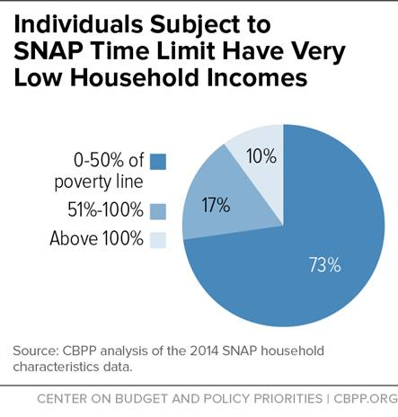
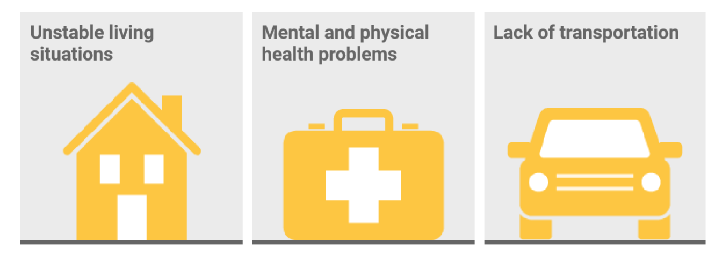
ABAWDs
There are an estimated 92,000 across PA (34,000 in Philadelphia)
They are some of our most vulnerable residents
  Many need additional training or education for today’s jobs
Nationally, almost 75% live in deep poverty (income below $12,140/year for one person)

Slide 6
SNAP 3-month Time Limit: What Is It?
It is a federal rule that limits ABAWDs to 3 months* of SNAP benefits in a 3 year (36 month) period unless they:
  Qualify for an “exemption”
  Work or participate in a work program at least 20 hours per week (averaged monthly)
  Are in school or training at least half-time (must meet other eligibility rules for students)
  Volunteer or perform community service to “work” for benefits, usually for 26 hours per month
  Live in an area waived due to insufficient jobs (very few will be as of April 1)
  *Partial months of benefits do not count toward the 3 month limit

Slide 7
SNAP 3-year Time Limit:
When?
Congress created the rule as part of welfare reform in 1996
New rule goes into effect April 1, 2020; with a 3-month time limit, the earliest an ABAWD would lose SNAP is July
PA has carry-over exemptions from prior years it must use by end of Sept.
DHS is evaluating whether it can use exemptions to delay implementation in some counties that face a large impact (possibly Allegheny, Cambria, Fayette, and Philadelphia)
Even with delayed implementation, ABAWDs who can qualify for exemptions should report the reason(s) to the CAO as soon as possible
PA will have a limited number of exemptions each year and plans to use those to help particularly vulnerable ABAWDs keep their SNAP benefits

Slide 8
When does the 3-month period run?
The 3-month clock starts with the first full month of SNAP benefits and adds to the count each full month benefits are received
  If SNAP benefits are not received each month, the clock stops
  The clock ends the last day of the third month
Once an ABAWD receives 3 countable months of benefits, he/she will not be eligible again until:
  The new three-year fixed period begins, OR
  They regain eligibility by meeting an exemption or the work and/or community service requirement
  They can get another 3 months if they’ve worked 80 hours/month (even if they leave the job)

Slide 9
When does the 3-year period run?
The 3-year clock is a fixed period for everyone in the state
The current 3-year fixed period is from Jan. 1, 2018 through Dec. 31, 2020 for the entire caseload
A new 3-year clock will begin Jan. 1, 2021 and run through Dec. 31, 2023
Each fixed 3-year fixed period, an ABAWD can receive a new count of 3-months of benefits

Slide 10
SNAP 3-month Time Limit:
Where?
Many counties in Pennsylvania have always qualified for a waiver from this rule
In 2019, 63 of 67 counties in Pennsylvania, as well as a few smaller municipalities, were waived from the rule
Starting April 1, just two counties – Forest and Mercer – are expected to qualify for a waiver (Mercer will lose it Dec. 31, 2020)
This is a tremendous change – and challenge – for PA and states around the country

Slide 11
SNAP 3-month Time Limit:
Why?
Changes to the ABAWDs rule were considered by Congress during Farm Bill negotiations
Those changes were rejected when Congress passed the Farm Bill in Dec. 2018
Instead, the Trump administration has used the rule making process to make this change
Areas now must have much higher levels of unemployment to qualify for a waiver

Slide 12
SNAP 3-month Time Limit:
How?
In the next section, we’ll discuss:
How the rule will be implemented in PA
How you can help clients keep their SNAP
Quick rule review: ABAWDs can get SNAP benefits for just 3 months in a 3 year period. To continue to get SNAP for longer, they must:
  Qualify for an “exemption”
  Work or participate in a work program at least 20 hours per week (80 hours/month)
  Be in school or training at least half-time
  Volunteer or perform community service for about 26 hours per month

Slide 13
Categories of Exemptions
Now is the time to help individuals start to get their paperwork in if they qualify for an exemption.
Exemption | Explanation
“Unfit for Work”* | Medical professional certifies individual will have trouble working (or unfitness is obvious)
Pregnancy | Being pregnant (may need to provide proof)
Meets another Exemption | Additional exemptions are listed on slide 15
* See slide 14

Slide 14
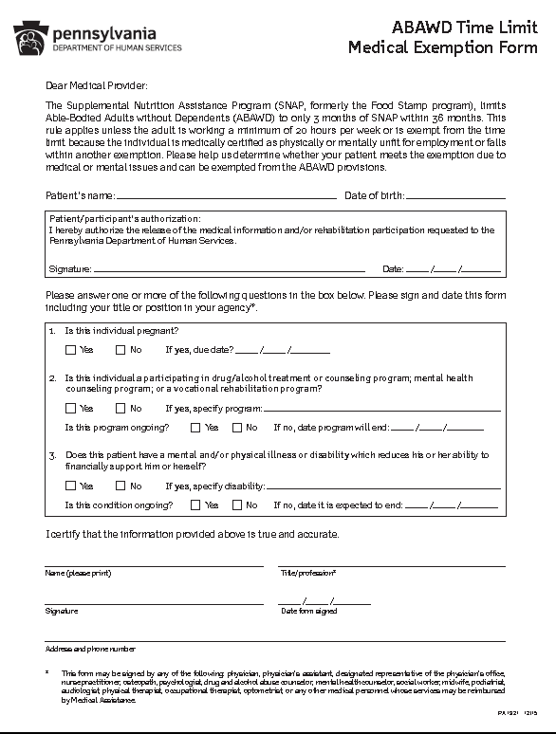
Medical Exemption Form – PA 1921
ABAWDs who cannot work due to medical reasons should have a medical provider complete an Medical Exemption Form
This includes those in drug or alcohol treatment or mental health treatment
The form should be submitted to the CAO as soon as possible
ABAWDs can also call the customer service center (Statewide: 877-395-8930; Philly: 215-560-7226) to ask that the form be mailed to them
Also available at www.clsphila.org/ABAWDS - or - www.hungercoalition.org/ABAWDS

Slide 15
Other Exemptions
(These are the “ETP” exemptions on earlier slide)
Homeless
Experienced domestic violence
Cares for ill or incapacitated person in the same home (does not need to be same SNAP household)
Enrolled in school or training at least half time (must meet other rules for students)
Expected to return to work within 60 days
Cares for a child in the household under age 6
Applying for or receiving Unemployment Compensation
Travel to work, education, training, or volunteer site is 2 or more hours (round trip)
Migrant/seasonal farm worker expected to work within 30 days

Slide 16
Time Limit Implementation at CAOs
SNAP applications & re-certifications* will include an ABAWD determination.
CAO workers will review all individuals age 18-49 to determine what category they are in:
Exempt
Has a child under 18 in the SNAP household
Disabled or “unfit for work”
Is pregnant
Meets another exemption (see slide 15)
Has met ABAWDs requirements
Works at least 20 hrs/week averaged monthly
Participates in an approved education or training program 20 hours/week*
Performs community service or volunteers for required hours (typically 26 hours/month)
*Job search does not count
The 3-month time limit applies
Is not exempt and does not live in a waived area
Has not met work, education, training or volunteer requirements
* Re-certifications occur every 3 months, rather than annually, for non-exempt ABAWDs

Slide 17
CAOs will inform ABAWDs of Time Limit
For individuals that do not meet an exemption during the SNAP interview, CAO workers are to:
Explain that starting April 1, they can receive just 3 months of SNAP benefits in the 3 year period if they do not:
  Qualify for an exemption
  Meet an ABAWD work, education/training, or volunteer requirement
DHS will mail ABAWDs a notice and survey (CM-558):
  When approved, informing them of the 3-month limit
  We are working to learn more about DHS’ exact process and pressing for clear and frequent communication to clients

Slide 18

ABAWD Exemption – Example 1
For all examples, assume the person lives in a county where the rule applies.
Derrick: 34-year-old man
Lives with his girlfriend, Amber, and her 13-year-old son, Jeremiah
They purchase and prepare meals together
They apply for SNAP benefits and are found eligible
Is Derrick an ABAWD?
Notes:
Let’s look at a few examples to determine who meets an ABAWD exemption.
Derrick, a 34-year-old man, lives in a non-waived area with his girlfriend, Amber, age 31, and her son, Jeremiah, who is 13-years-old. They purchase and prepare meals together. They apply for SNAP benefits and are found eligible. Does Derrick meet any ABAWD exemptions?

Slide 19
ABAWD Exemption – Example 1
No
Derrick is not considered an ABAWD because he receives SNAP with Jeremiah, who is under age 18 (they are part of the same SNAP household)
Notes:
Let’s look at a few examples to determine who meets an ABAWD exemption.
Derrick, a 34-year-old man, lives in a non-waived area with his girlfriend, Amber, age 31, and her son, Jeremiah, who is 13-years-old. They purchase and prepare meals together. They apply for SNAP benefits and are found eligible. Does Derrick meet any ABAWD exemptions?

Slide 20

ABAWD Exemption – Example 2
Kevin applies for SNAP benefits for himself and his minor son, Cory, in July for that month
Cory’s mom has custody of him during the school year and receives SNAP benefits for Cory and herself
Kevin has custody during the summer
Kevin thinks the ABAWDs rule does not apply to him because of Cory. Is that right?
Notes:
Yes. Derrick does meet an ABAWD exemption because Jeremiah is under age 18 and is a part of the same SNAP household.

Slide 21
ABAWD Exemption – Example 2
No
Because Cory is already part of his mom’s SNAP household, Kevin considered an ABAWD
Kevin is subject to the 3-month time limit, unless:
  Cory is under age 6 (meets the caring for a child under age 6 exemption) – OR –
  Cory’s mom agrees to let Kevin get SNAP for Cory in the summer
Notes:
Yes. Derrick does meet an ABAWD exemption because Jeremiah is under age 18 and is a part of the same SNAP household.

Slide 22

ABAWD Exemption – Example 3
Janice is a single 47-year-old woman, has no children, lives in Philadelphia
Applied for SNAP and has a mental disability that prevents her from working, but the disability is not obvious
Was given a PA 1921 to have completed by her medical provider but has not returned it to the CAO
Does she meet any exemptions?
Notes:
Janice, a 47-year-old single woman with no children, lives in a non-waived area. She applied for SNAP and claimed that she has a mental disability that prevents her from working. She was given a PA 1663 for her physician to complete but has yet to return it to the CAO. Does Janice meet any ABAWD exemptions?

Slide 23
ABAWD Exemption – Example 3
No
Janice does not meet any other ABAWD exemptions, and has not yet provided certification of her disability
If she gets the PA-1921 filled out and submitted, she can remain eligible
Community groups can help! (Many providers can sign the PA-1921)
Notes:
Janice, a 47-year-old single woman with no children, lives in a non-waived area. She applied for SNAP and claimed that she has a mental disability that prevents her from working. She was given a PA 1663 for her physician to complete but has yet to return it to the CAO. Does Janice meet any ABAWD exemptions?

Slide 24
Meeting required hours through work
What if an ABAWD works fewer than 20 hours/week?
If an ABAWD is scheduled for 20 hours/week but misses hours through no fault of his/her own (holidays, illness, transportation problems):
He or she should report this to the CAO, and ask for a GOOD CAUSE review so that he/she can continue to qualify for SNAP
If an ABAWD is regularly scheduled for less than 20 hours/week:
He or she must do other permitted activities, such a volunteering or training, to get up to 20 hours a week.
Job search can count for up to 10 hours/week

Slide 25
Non-Work Activities that meet the
20 hour/week requirement
  Activities that can meet 20 hours/week requirement (alone or in combination):
  Advanced degree (college) classes
  Skill/Vocational training classes
  English-as-a-Second Language (ESL) classes
  Adult Basic Education (ABE)/ Literacy classes
  GED/High school remediation classes
  Work experience/vocational experience
  Programs through Career Links (WIOA programs)
  Community service/ workfare
  *Remember, those in school at least half time are exempt. They do not need to combine hours with other activities.

Slide 26
Community Service/Workfare
ABAWDs can comply with the rule by volunteering with a non-profit or government site
Required hours are the monthly SNAP grant divided by the minimum wage (the $194 maximum grant for one person, divided by $7.25 = 26 hours/month)
ABAWDs will be allowed to find volunteer sites/opportunities on their own (“self-directed community service”)
Details for how ABAWDs will report hours are still being finalized (we will update our websites when new information is available)
Volunteer sites may be asked to sign a Community Service Agency Agreement (PA 1694 is currently being revised)

Slide 27
SNAP Employment & Training
DHS has some employment and training slots to help ABAWDs comply and continue to receive SNAP
There are a limited number of programs and slots, and some have specific requirements clients must meet to be accepted
Clients who are interested must be referred to employment and training by the CAO
He/she can ask at the CAO, or, call the customer service center and ask that “a ticket be sent to their CAO worker for an E&T referral” to start the process
    Statewide: 877-395-8930
    Philly: 215-560-7226

Slide 28

Complying with Hours – Example 1
Rose is a 35-year old single woman
She receives full months of SNAP benefits in Aug., Sept., and Oct. and has a renewal interview on Oct. 21
At the interview, Rose reports having worked 20 hours in the previous week and expects to continue to work 20 hours/week
The CAO verifies the employment
Can Rose continue to receive SNAP?
Notes:
No. Janice does not meet any other ABAWD exemptions, and she has not yet provided certification of her disability.

Slide 29
Complying with Hours – Example 1
Yes
Rose is now meeting the work requirement
Her SNAP eligibility now continues uninterrupted
Notes:
No. Janice does not meet any other ABAWD exemptions, and she has not yet provided certification of her disability.

Slide 30
Regaining SNAP After a Cutoff
ABAWDs can reapply and get SNAP back if:
  Become exempt
  Meet the 20 hour/week work requirement (or work off the SNAP through community service)
  Move to an area with a geographic waiver
Even if an ABAWD doesn’t otherwise qualify, he/she can get another 3 months of SNAP if in any 30-day period since last got SNAP, have:
Worked 80 hours, or
Participated in a training program for 80 hours
A new 3-year period for all ABAWDs will start 1/1/2021.

Slide 31

Regaining SNAP – Example 1
Anthony is a 46-year old single man He receives three full months of SNAP benefits in Jan., Feb., and March, and benefits stop due to the time limit
Anthony reapplies for SNAP in Nov. of the same year and is now receiving unemployment compensation
His unemployment compensation income is within SNAP income limits
Is Anthony eligible?
Notes:
No. Janice does not meet any other ABAWD exemptions, and she has not yet provided certification of her disability.

Slide 32
Regaining SNAP – Example 1
Yes
Receiving Unemployment is a federal E&T exemption from ABAWD requirements
Anthony’s SNAP eligibility has been regained because he is now meeting an exemption
SNAP benefits can be authorized on an ongoing basis
Notes:
No. Janice does not meet any other ABAWD exemptions, and she has not yet provided certification of her disability.

Slide 33
Recap: What you can do to help clients now
Inform clients this rule is coming
Help them understand the rule
Help them establish exemptions, including assisting with paperwork (like submission of the PA-1921)
Help them identify community service or volunteer opportunities
Some agencies may be able to provide community service/volunteer slots

Slide 34
Additional Information & Updates
For more information:
  www.clsphila.org/ABAWDs
  www.hungercoalition.org/ABAWDs
Websites will be updated as new information becomes available
Questions? Email: Lhayes@clsphila.org – or – kfisher@hungercoalition.org
Coalition Against Hunger SNAP Hotline: 215-430-0556
Additional SNAP Hotlines:
Central PA Food Bank: 877-999-5964 (serving Central PA)
Just Harvest: (412) 431-8960 x 602
Greater Pittsburgh Community Food Bank: 1-833-822-SNAP (7627) (Southwest PA)
Second Harvest Food Bank of the Lehigh Valley: 866-203-3323 (Northeast PA)
Second Harvest Food Bank of Northwest PA 814-459-3663 x 118 (Northwest PA)

